Slide 1


Delivering the world’s most sustainable
PC portfolio¹
This slide contains a superlative claim/s that cannot be used in all countries:
EMEA Use Restrictions: DO NOT USE the superlative claim in the following countries: Romania, Slovakia, Turkey, UAE, Russia, CIS countries (Armenia, Belarus, Kazakhstan, Kyrgyzstan, Moldova, Russia, Tajikistan, Turkmenistan, Ukraine, and Uzbekistan),
APJ Use Restrictions: China, Vietnam, Indonesia, Malaysia – DO NOT use
LAR Use Restrictions: Brazil, Mexico – Do NOT use
Z by HP
February 2023
HP Confidential. For use by HP or Partner with Customers under HP CDA only.
Notes:
Disclaimer
1. Applies to HP PCs, Workstations and Displays manufactured after January 2019. Based on most Gold and Silver EPEAT® registrations by meeting all required criteria and achieving 50-74% of the optional points for EPEAT® Silver and 75-100% of the optional points for EPEAT® Gold according to IEEE 1680.1-2018 EPEAT®. Status varies by country. Visit www.epeat.net for more information.
This slide contains a superlative claim/s that cannot be used in all countries:
EMEA Use Restrictions: DO NOT USE the superlative claim in the following countries: Romania, Slovakia, Turkey, UAE, Russia, CIS countries (Armenia, Belarus, Kazakhstan, Kyrgyzstan, Moldova, Russia, Tajikistan, Turkmenistan, Ukraine, and Uzbekistan),
APJ Use Restrictions: China, Vietnam, Indonesia, Malaysia – DO NOT use
LAR Use Restrictions: Brazil, Mexico – Do NOT use

Slide 2

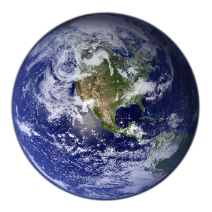

By 2050
2.3
Earths will be needed
To sustain the resource demands of our global population
HP Confidential. For use by HP or Partner with Customers under HP CDA only.
Notes:
Why do we believe not a fad? Several megatrends we are watching summed up by 2.3 earths in 2050
Opportunity from growing middle class: phones
Population growth, urbanization
Climate/environmental pressure (Water shortage Calif, air pollution Beijing or haze in Singapore)

Slide 3
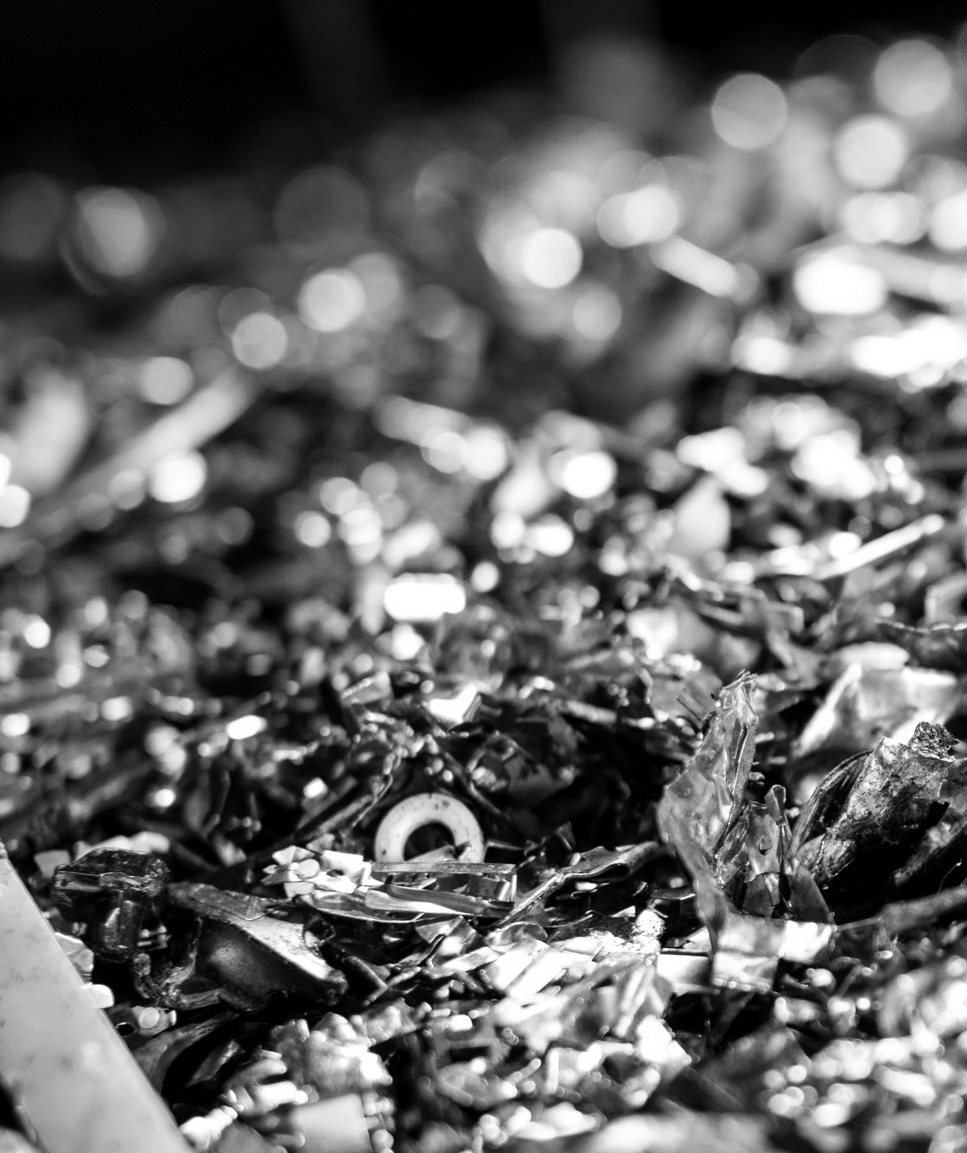


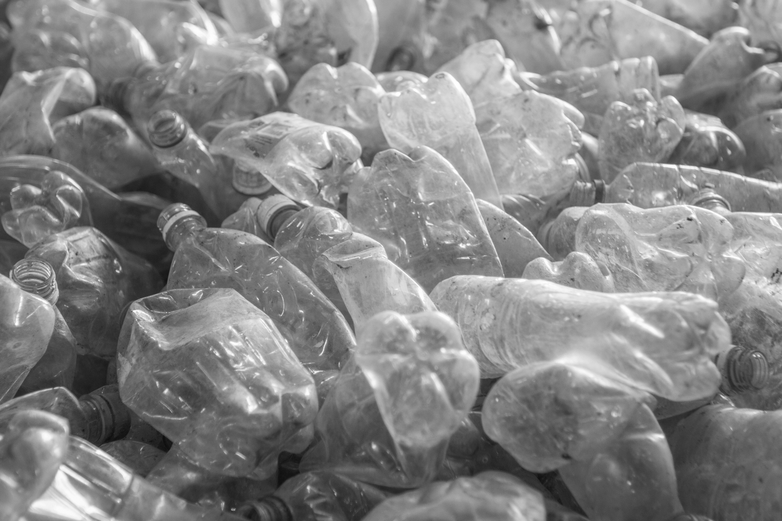


Sustainability
Progress
1145
More than 11 million pounds of recycled
metal used is equivalent to the weight
of 1145 of elephants
100%
of PCs, workstations and displays launched YTD FY22* contained recycled materials
100%
of HP's Dragonfly, Elite, Z, Envy, Pavilion and Spectre portfolios have EPEAT® Gold registration in the U.S.
More than 72 million pounds of recycled
Plastic in PS products is equivalent to the
Weight of 316 adult Blue whales
316
* As of FY22Q3
* US registrations
HP Confidential. For use by HP or Partner with Customers under HP CDA only.
Notes:
*as of FY22Q3

Slide 4




vision.
Become the worlds most sustainable and just technology company.
Planet
People
Community
Climate Action
Human rights
Digital equity
Drive toward a net zero carbon, fully regenerative economy while engineering the industry’s most sustainable portfolio of products and solutions.
Create a powerful culture of diversity, equity and inclusion. Advance human rights, social justice, and racial and gender equality across our ecosystem, raising the bar for all.
Lead in activating and innovating holistic solutions that break down the digital divide that prevents many from accessing the education, jobs and healthcare needed to thrive. Drive digital inclusion to transform lives and communities.
Carbon emissions
Circularity
Forests
Culture of inclusion & belonging
Social justice, racial & gender equity
Empowered workers
Education
Healthcare
Economic opportunity
HP Confidential. For use by HP or Partner with Customers under HP CDA only.

Slide 5


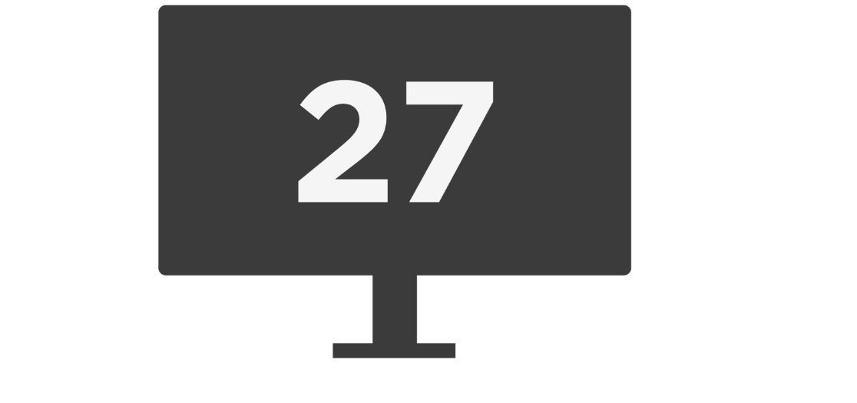

The world’s most sustainable
PC portfolio¹
27
^{100%}
HP recognized as an ENERGY STAR® Partner of the Year in 2022,
5th year in a row
Elite, Dragonfly & Z are all EPEAT® Gold registered in the US²
HP displays recognized as Most Efficient by ENERGY STAR® in 2021
HP Confidential. For use by HP or Partner with Customers under HP CDA only.
Notes:
Disclaimer
1. Applies to HP PCs, Workstations and Displays manufactured after January 2019. Based on most Gold and Silver EPEAT® registrations by meeting all required criteria and achieving 50-74% of the optional points for EPEAT® Silver and 75-100% of the optional points for EPEAT® Gold according to IEEE 1680.1-2018 EPEAT®. Status varies by country. Visit www.epeat.net for more information.
2. Based on US EPEAT® registration according to IEEE 1680.1-2018 EPEAT®. EPEAT® status varies by country. Visit www.epeat.net for more information
This slide contains a superlative claim/s that cannot be used in all countries:
EMEA Use Restrictions: DO NOT USE the superlative claim in the following countries: Romania, Slovakia, Turkey, UAE, Russia, CIS countries (Armenia, Belarus, Kazakhstan, Kyrgyzstan, Moldova, Russia, Tajikistan, Turkmenistan, Ukraine, and Uzbekistan),
APJ Use Restrictions: China, Vietnam, Indonesia, Malaysia – DO NOT use
LAR Use Restrictions: Brazil, Mexico – Do NOT use
To support this commitment to the planet we are committed to deliver the world’s most sustainable PC portfolio.
In fact, 100% of our Commercial portfolio is certified EPEAT Gold by the Global Electronics Council — the highest possible rating for low environmental impact.
HP’s journey to integrate recycled materials started in 2019 with the HP Dragonfly; and now has grown to include nearly every commercial product category.
And not only have the products including sustainable materials grown, the types of sustainable materials we use has broadened, to now include recycled magnesium, aluminum, and a broader spectrum of plastics.
We also continue to be among the industry leaders in responsible packaging and are always looking for ways to reduce the environmental impact of how we package and distribute our products.

Slide 6

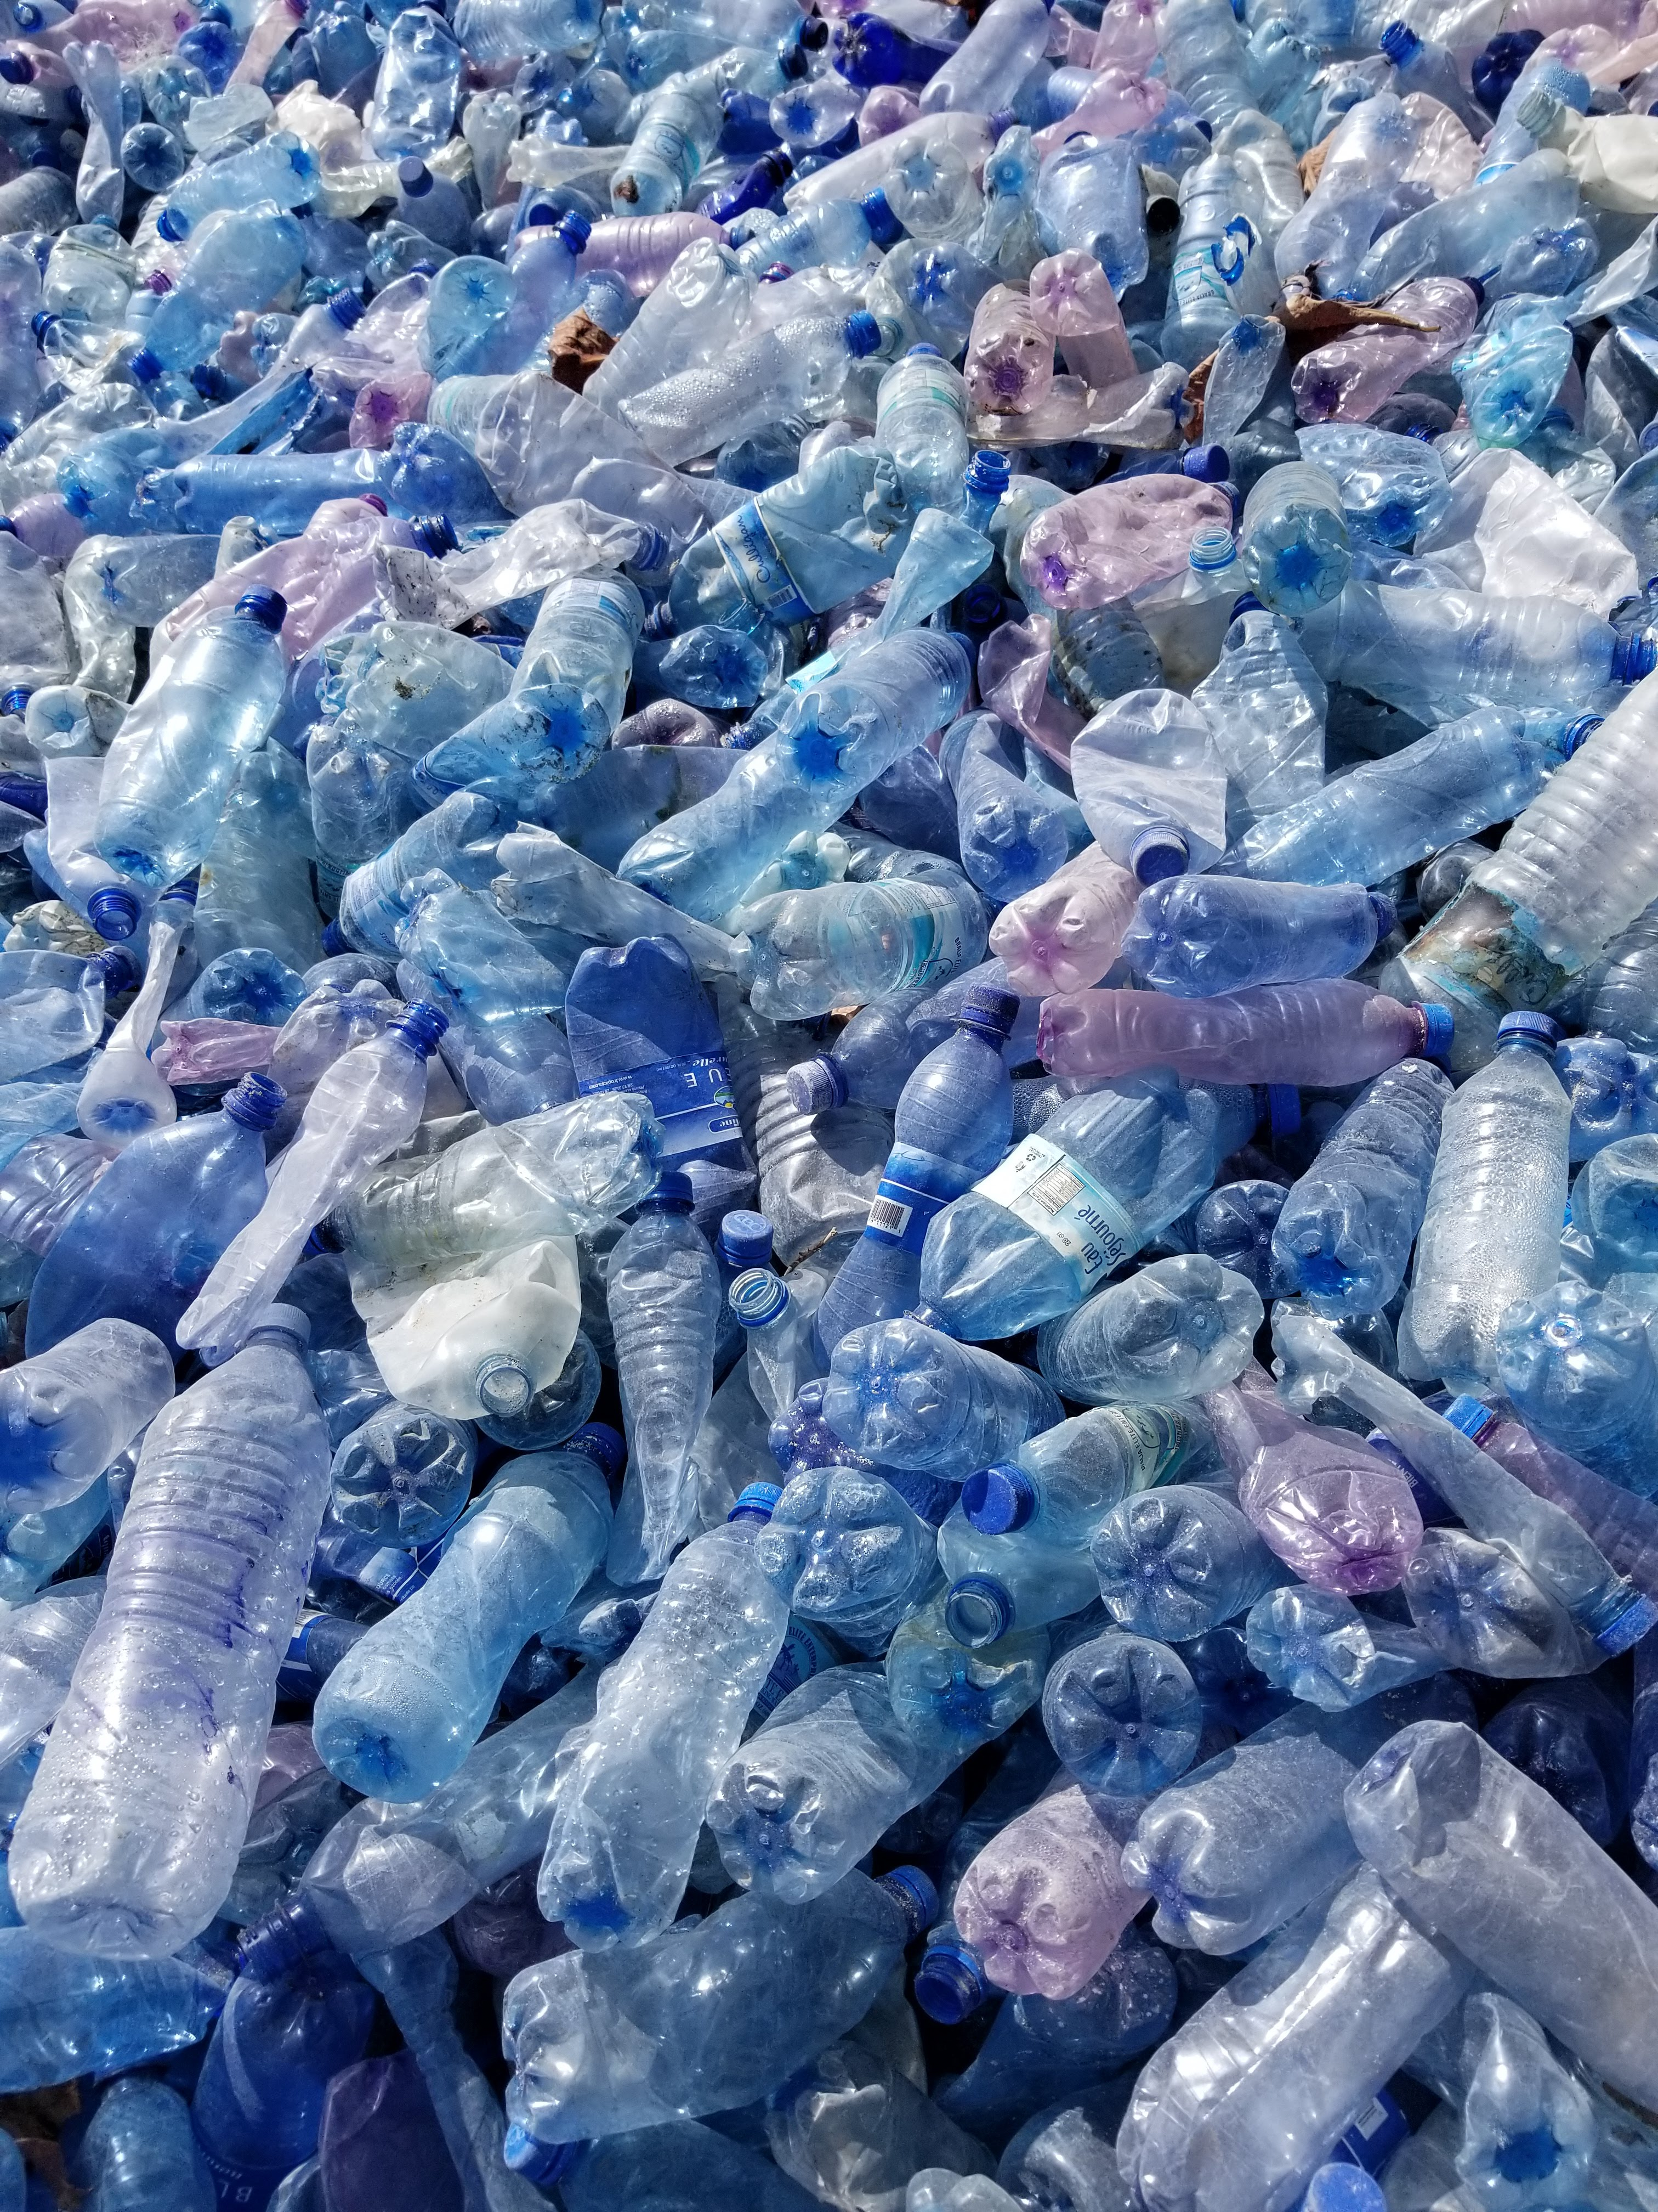
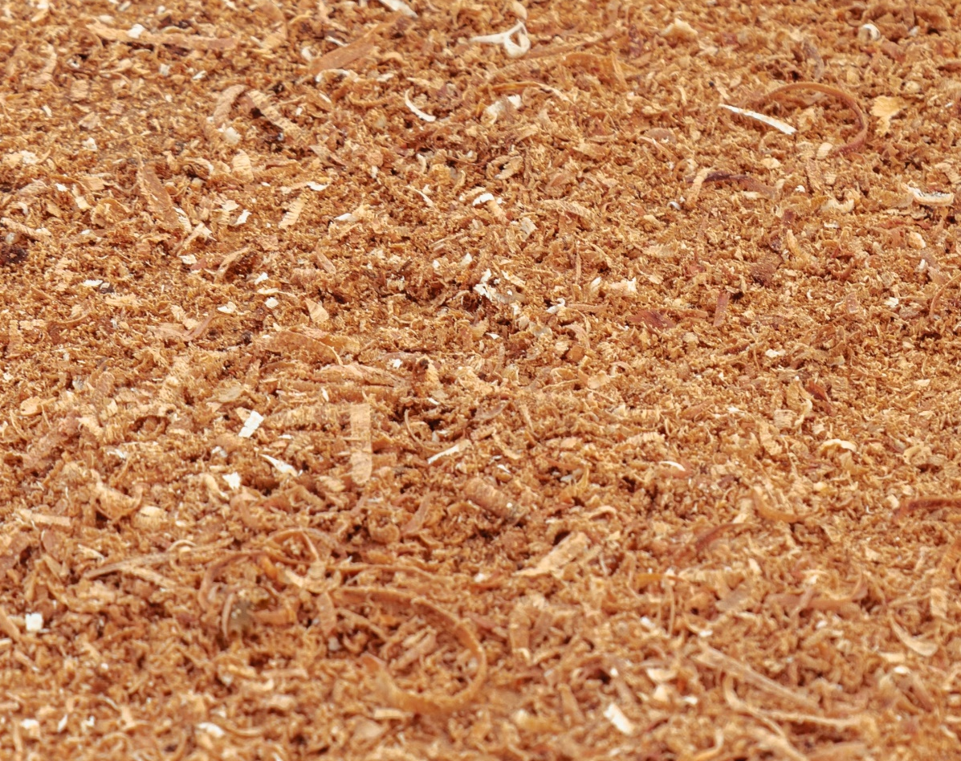
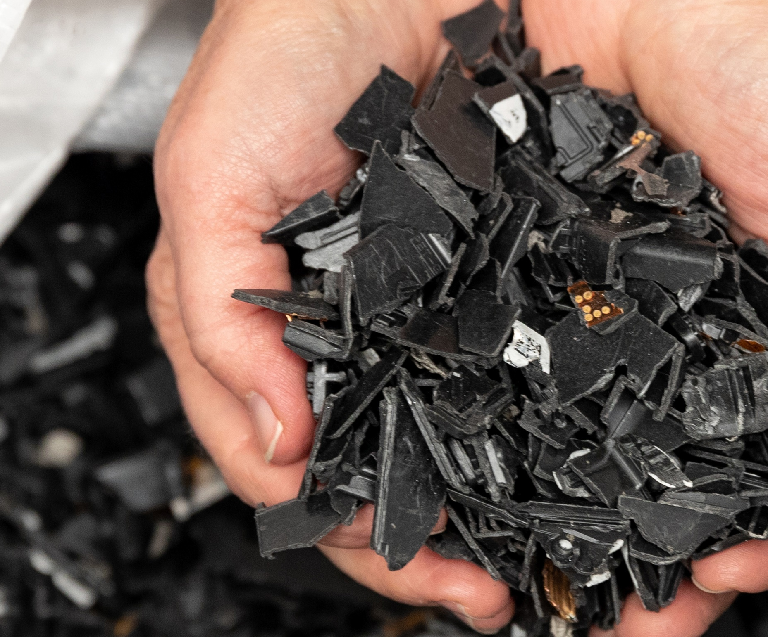
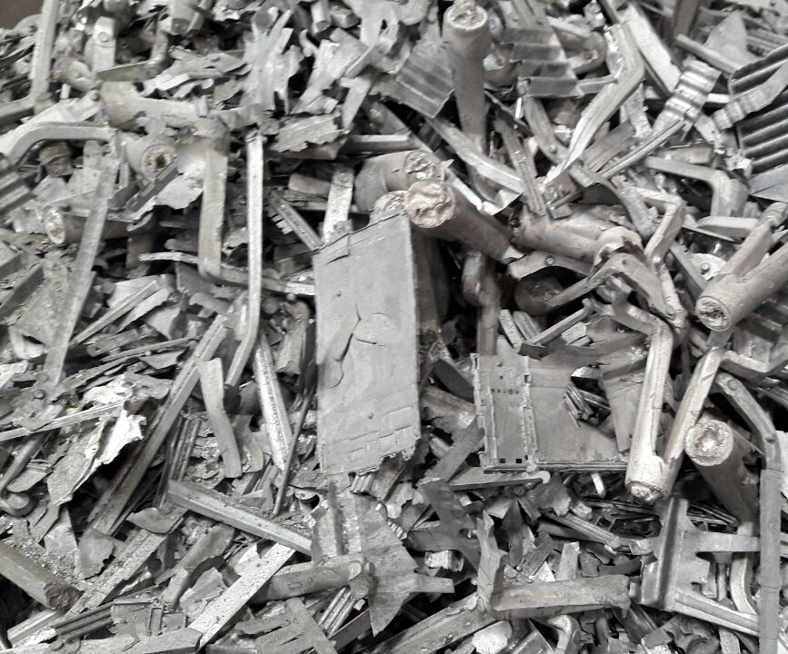
MATERIALS
Materials
100% >18.7m 100% 90%
of all paper-based packaging for PS products have been derived from recycled and/or certified sustainable sources
bottles diverted from the ocean, in the 243 products launched containing ocean-bound plastic
of displays launched in Q1 22 had >80% recycled plastics
recycled content on all magnesium use on PC products
HP Confidential. For use by HP or Partner with Customers under HP CDA only.

Slide 7
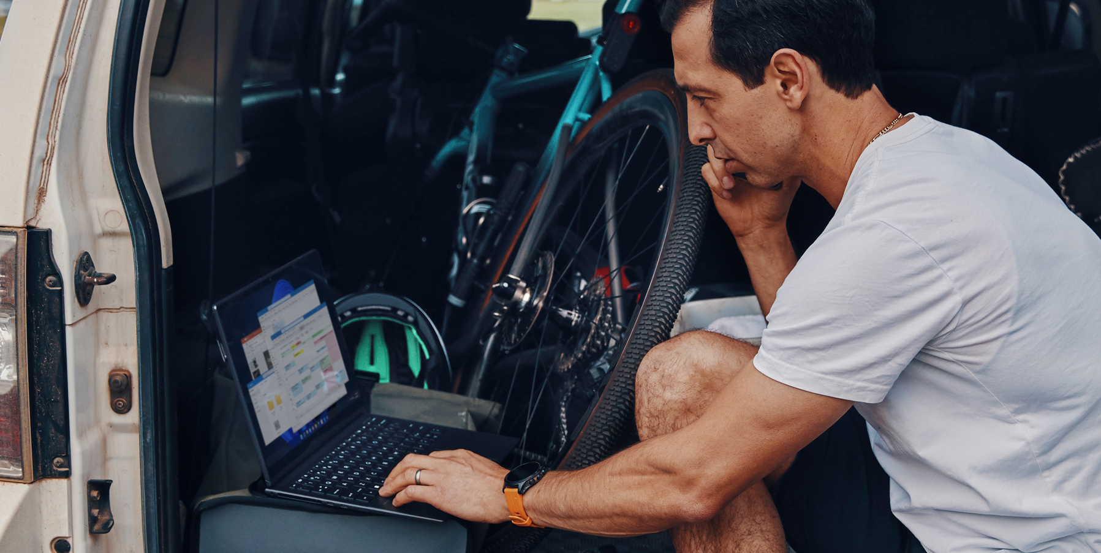
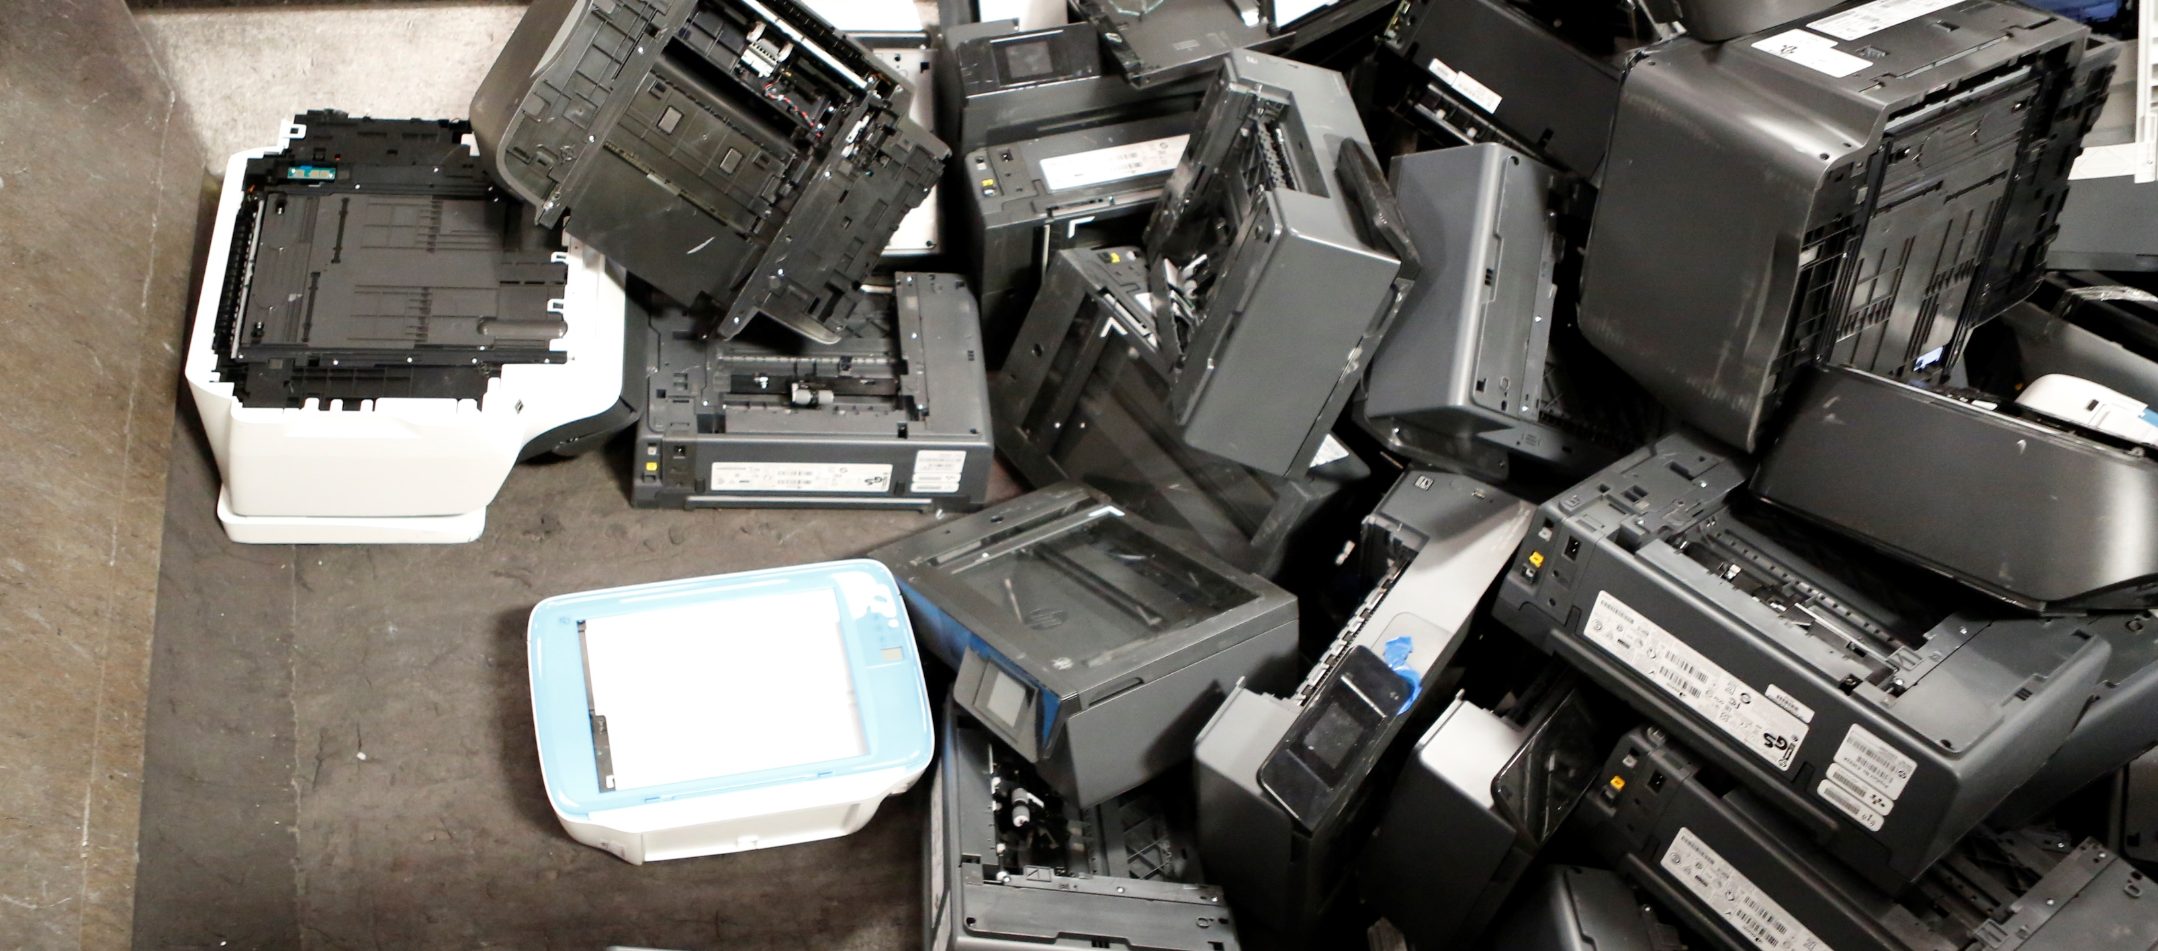
Together in this journey
  Embrace our products confidently
  Recycle securely & responsibly
Attract and retain the best talent, with industry leading designs, technology and responsibility.
Work with HP to refurbish and redeploy your older technology in communities where it can make a difference.
HP Confidential. For use by HP or Partner with Customers under HP CDA only.

Slide 8
Z by HP
Sustainability
March 2023
HP Confidential. For use by HP or Partner with Customers under HP CDA only.

Slide 9


The world’s most sustainable
PC portfolio¹
Meet Your Sustainability Goals with Z by HP
Portfolio Planned
EPEAT® Gold²
Ocean-Bound Plastic Usage³
Bulk Packaging
ENERGY STAR® Certified
Plastic-Free Packaging Cushions (molded pulp)
HP Confidential. For use by HP or Partner with Customers under HP CDA only.
Notes:
To support this commitment to the planet we are committed to deliver the world’s most sustainable PC portfolio.
In fact, 100% of our Commercial portfolio is certified EPEAT Gold by the Global Electronics Council — the highest possible rating for low environmental impact.
HP’s journey to integrate recycled materials started in 2019 with the HP Dragonfly; and now has grown to include nearly every commercial product category.
And not only have the products including sustainable materials grown, the types of sustainable materials we use has broadened, to now include recycled magnesium, aluminum, and a broader spectrum of plastics.
We also continue to be among the industry leaders in responsible packaging and are always looking for ways to reduce the environmental impact of how we package and distribute our products.
Disclaimer
1. Applies to HP PCs, Workstations and Displays manufactured after January 2019. Based on most Gold and Silver EPEAT® registrations by meeting all required criteria and achieving 50-74% of the optional points for EPEAT® Silver and 75-100% of the optional points for EPEAT® Gold according to IEEE 1680.1-2018 EPEAT®. Status varies by country. Visit www.epeat.net for more information.
2. Based on US EPEAT® registration according to IEEE 1680.1-2018 EPEAT®. EPEAT® status varies by country. Visit www.epeat.net for more information
3. In 2020, all new launches of HP Elite, HP Pro, and Z Workstation desktop and notebook computers will include ocean bound plastic material.
Speaker enclosure made with 5% ocean bound plastic.
Applies to all products launching after January 1, 2020.
Claim can be used with HP or Environmental marketing messaging.
Claim can be used with portfolio messaging only when referencing product models launched after January 1, 2020. (No general messaging of HP Elite, HP Pro, and Z Workstation desktop and notebook computers made with ocean bound plastic without referencing a product(s) launched after January 1, 2020).
This slide contains a superlative claim/s that cannot be used in all countries:
EMEA Use Restrictions: DO NOT USE the superlative claim in the following countries: Romania, Slovakia, Turkey, UAE, Russia, CIS countries (Armenia, Belarus, Kazakhstan, Kyrgyzstan, Moldova, Russia, Tajikistan, Turkmenistan, Ukraine, and Uzbekistan),
APJ Use Restrictions: China, Vietnam, Indonesia, Malaysia – DO NOT use
LAR Use Restrictions: Brazil, Mexico – Do NOT use

Slide 10

All Z Workstations are EPEAT® Gold Certified ⁴
What is EPEAT®?
HP Z2 Mini G9
HP Z2 SFF G9
HP Z2 Tower G9
HP Z4 G4 & G5 Workstations
HP Z6 G4 & G5 Workstations
HP Z8 G4 & G5 Workstations
DESKTOP
WORKSTATIONS
EPEAT® is a global and comprehensive ecolabel. The purpose of this ecolabel is to help customers in the public and private sectors evaluate, compare and select products based on environmental attributes.
HP ZBook Studio G8 & G9
HP ZBook Power G8 & G9
HP ZBook Fury G8 & G9
HP ZBook Firefly G8 & G9
MOBILE
WORKSTATIONS
HP Confidential. For use by HP or Partner with Customers under HP CDA only.
Notes:
Eco labels are voluntary-manufacturers are not REQUIRED to do this by law.
Instead HP CHOOSES to design to these standards due to environmental commitment and customer demand. EPEAT is the world’s most comprehensive ecolabel, EPEAT helps customers evaluate product sustainability based on environmental attributes.
Products are measured against both required and optional criteria. A product must meet all of the required criteria in its category to be added to the registry. It is then rated Bronze, Silver or Gold depending on how many of the optional criteria it meets:
Gold—product meets all required criteria plus at least 75% of the optional criteria
Silver—product meets all required criteria plus at least 50% of the optional criteria
Bronze—product meets all required criteria
The EPEAT criteria reflects several categories of environmental attributes that cover the full lifecycle of electronic products, including:
• Reduction/elimination of environmentally sensitive materials
• Material selection
• Design for end of life
• Product longevity/life extension
• Energy conservation
• End-of-life management
• Corporate performance
• Packaging
• Consumables (unique to imaging equipment standard)
• Indoor air quality (unique to imaging equipment standard)
Disclaimers:
#4 Based on US EPEAT® registration according to IEEE 1680.1-2018 EPEAT®. EPEAT® status varies by country. Visit www.epeat.net for more information. All of our Workstations are EPEAT Gold Certified except HP ZCentral 4R Workstation

Slide 11
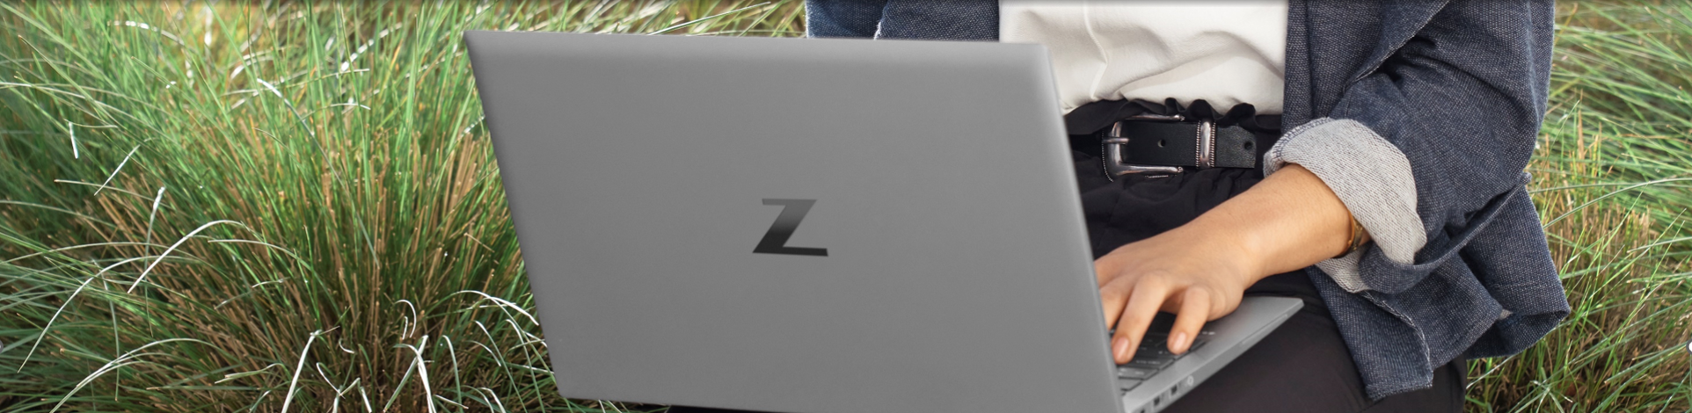



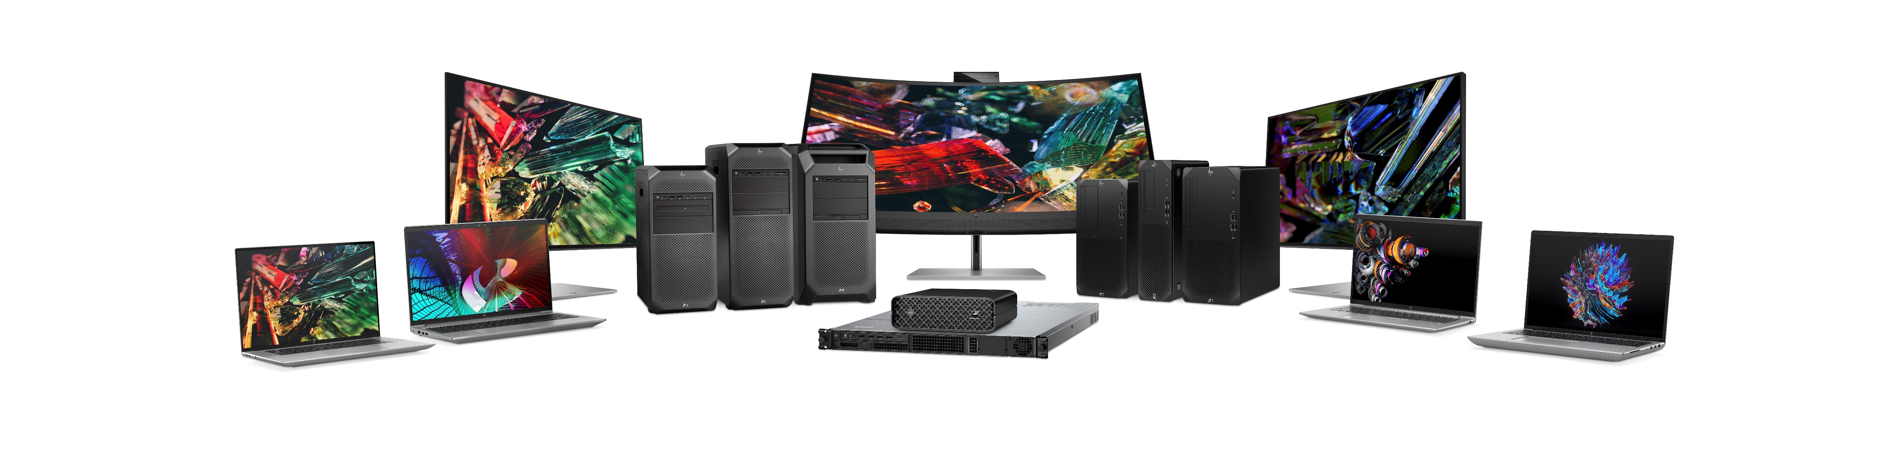
Z Workstations
Making new PCs out of old ones
Repurpose recycled and closed loop plastics in Z workstation portfolio
HP is the first workstation manufacturer to use at least 10% closed loop recycled plastics⁵
Support development of circular economy via the use of recycled materials
Notes:
Z by HP makes new PCs out of one old ones by using plastic that has been recycled and repurposes it across the Z Desktop and ZBook Portfolio.
HP is the first Workstation manufacturer to make new Workstations by using plastic that has been recycled from discarded IT equipment. This promotes a circular economy for both HP and our customers.
In order to create products with less environmental impact and waste, Z by HP incorporates recycled and closed loop plastics in our products.
Reduces the need for new resin to be manufactured which conserves earth’s resources
Diverts plastic from landfills or incinerators and reuses the plastic in new products
Better for the earth at cost parity.
All Z by HP products contain recycled plastic and the amount is growing. HP’s goal is that all HP products will contain on average 30% recycled plastic by 2025. Note that HP is going beyond EPEAT in this category. HP is continuously innovating ways to add recycled and closed loop plastics in products.
Z displays use 85% post-consumer recycled content (TCO certified Edge)
HP is also introducing Ocean Bound recycled plastics into many products within our portfolio which I will detail on the next slide.
DISCLAIMER:
5. Based on HP's internal analysis of workstation manufacturers as of October 2019. Applicable to the HP Z4, Z6, and Z8 G4.
This slide contains a superlative claim/s that cannot be used in all countries:
EMEA Use Restrictions:
DO NOT USE the superlative claim in the following countries:
Romania, Slovakia, Turkey, UAE, Russia, CIS countries (Armenia, Belarus, Kazakhstan, Kyrgyzstan, Moldova, Russia, Tajikistan, Turkmenistan, Ukraine, and Uzbekistan), Indonesia, Vietnam, Malaysia
APJ Use Restrictions:
China, Vietnam, Indonesia, Malaysia – DO NOT use
LAR Use Restrictions:
Brazil, Mexico – Do NOT use

Slide 12
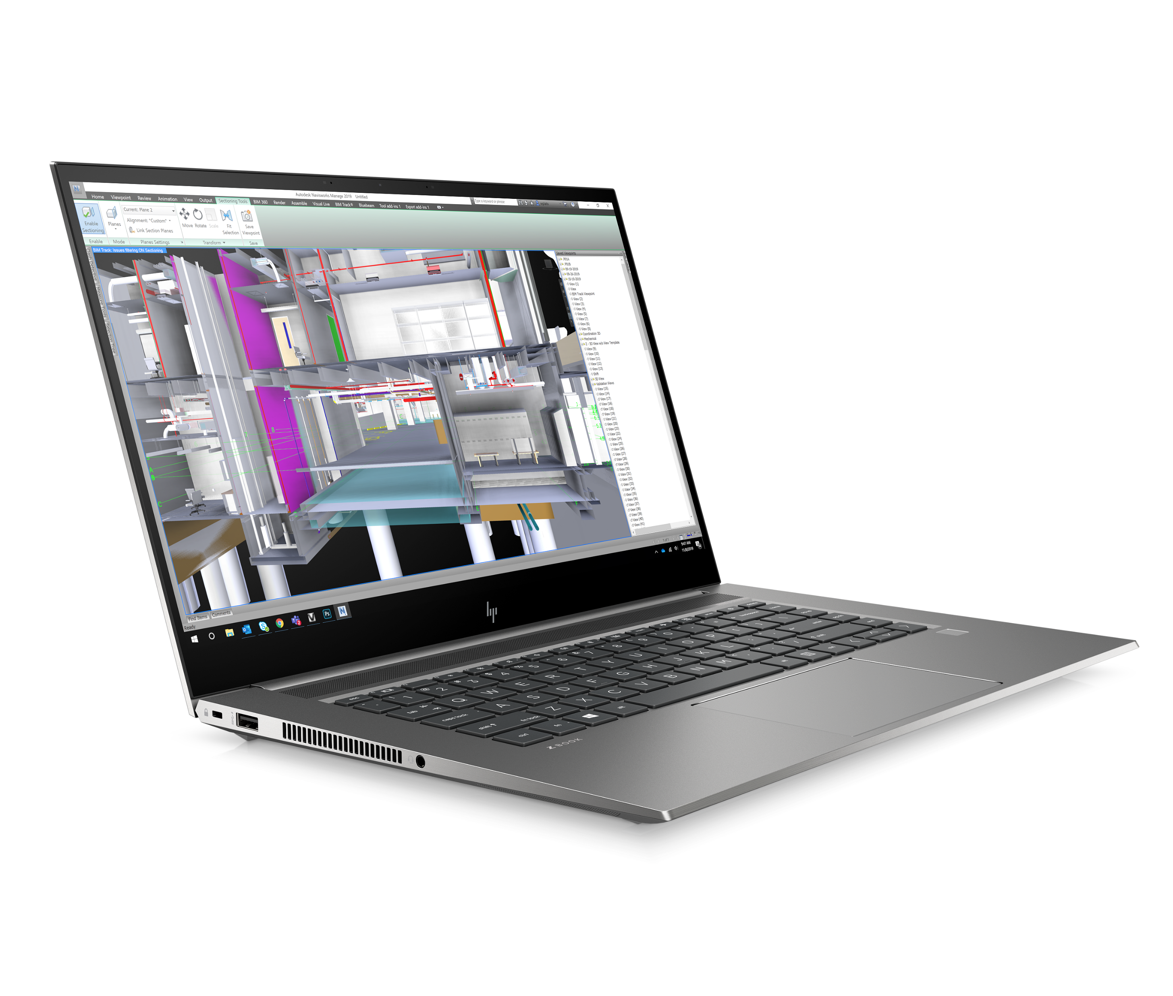
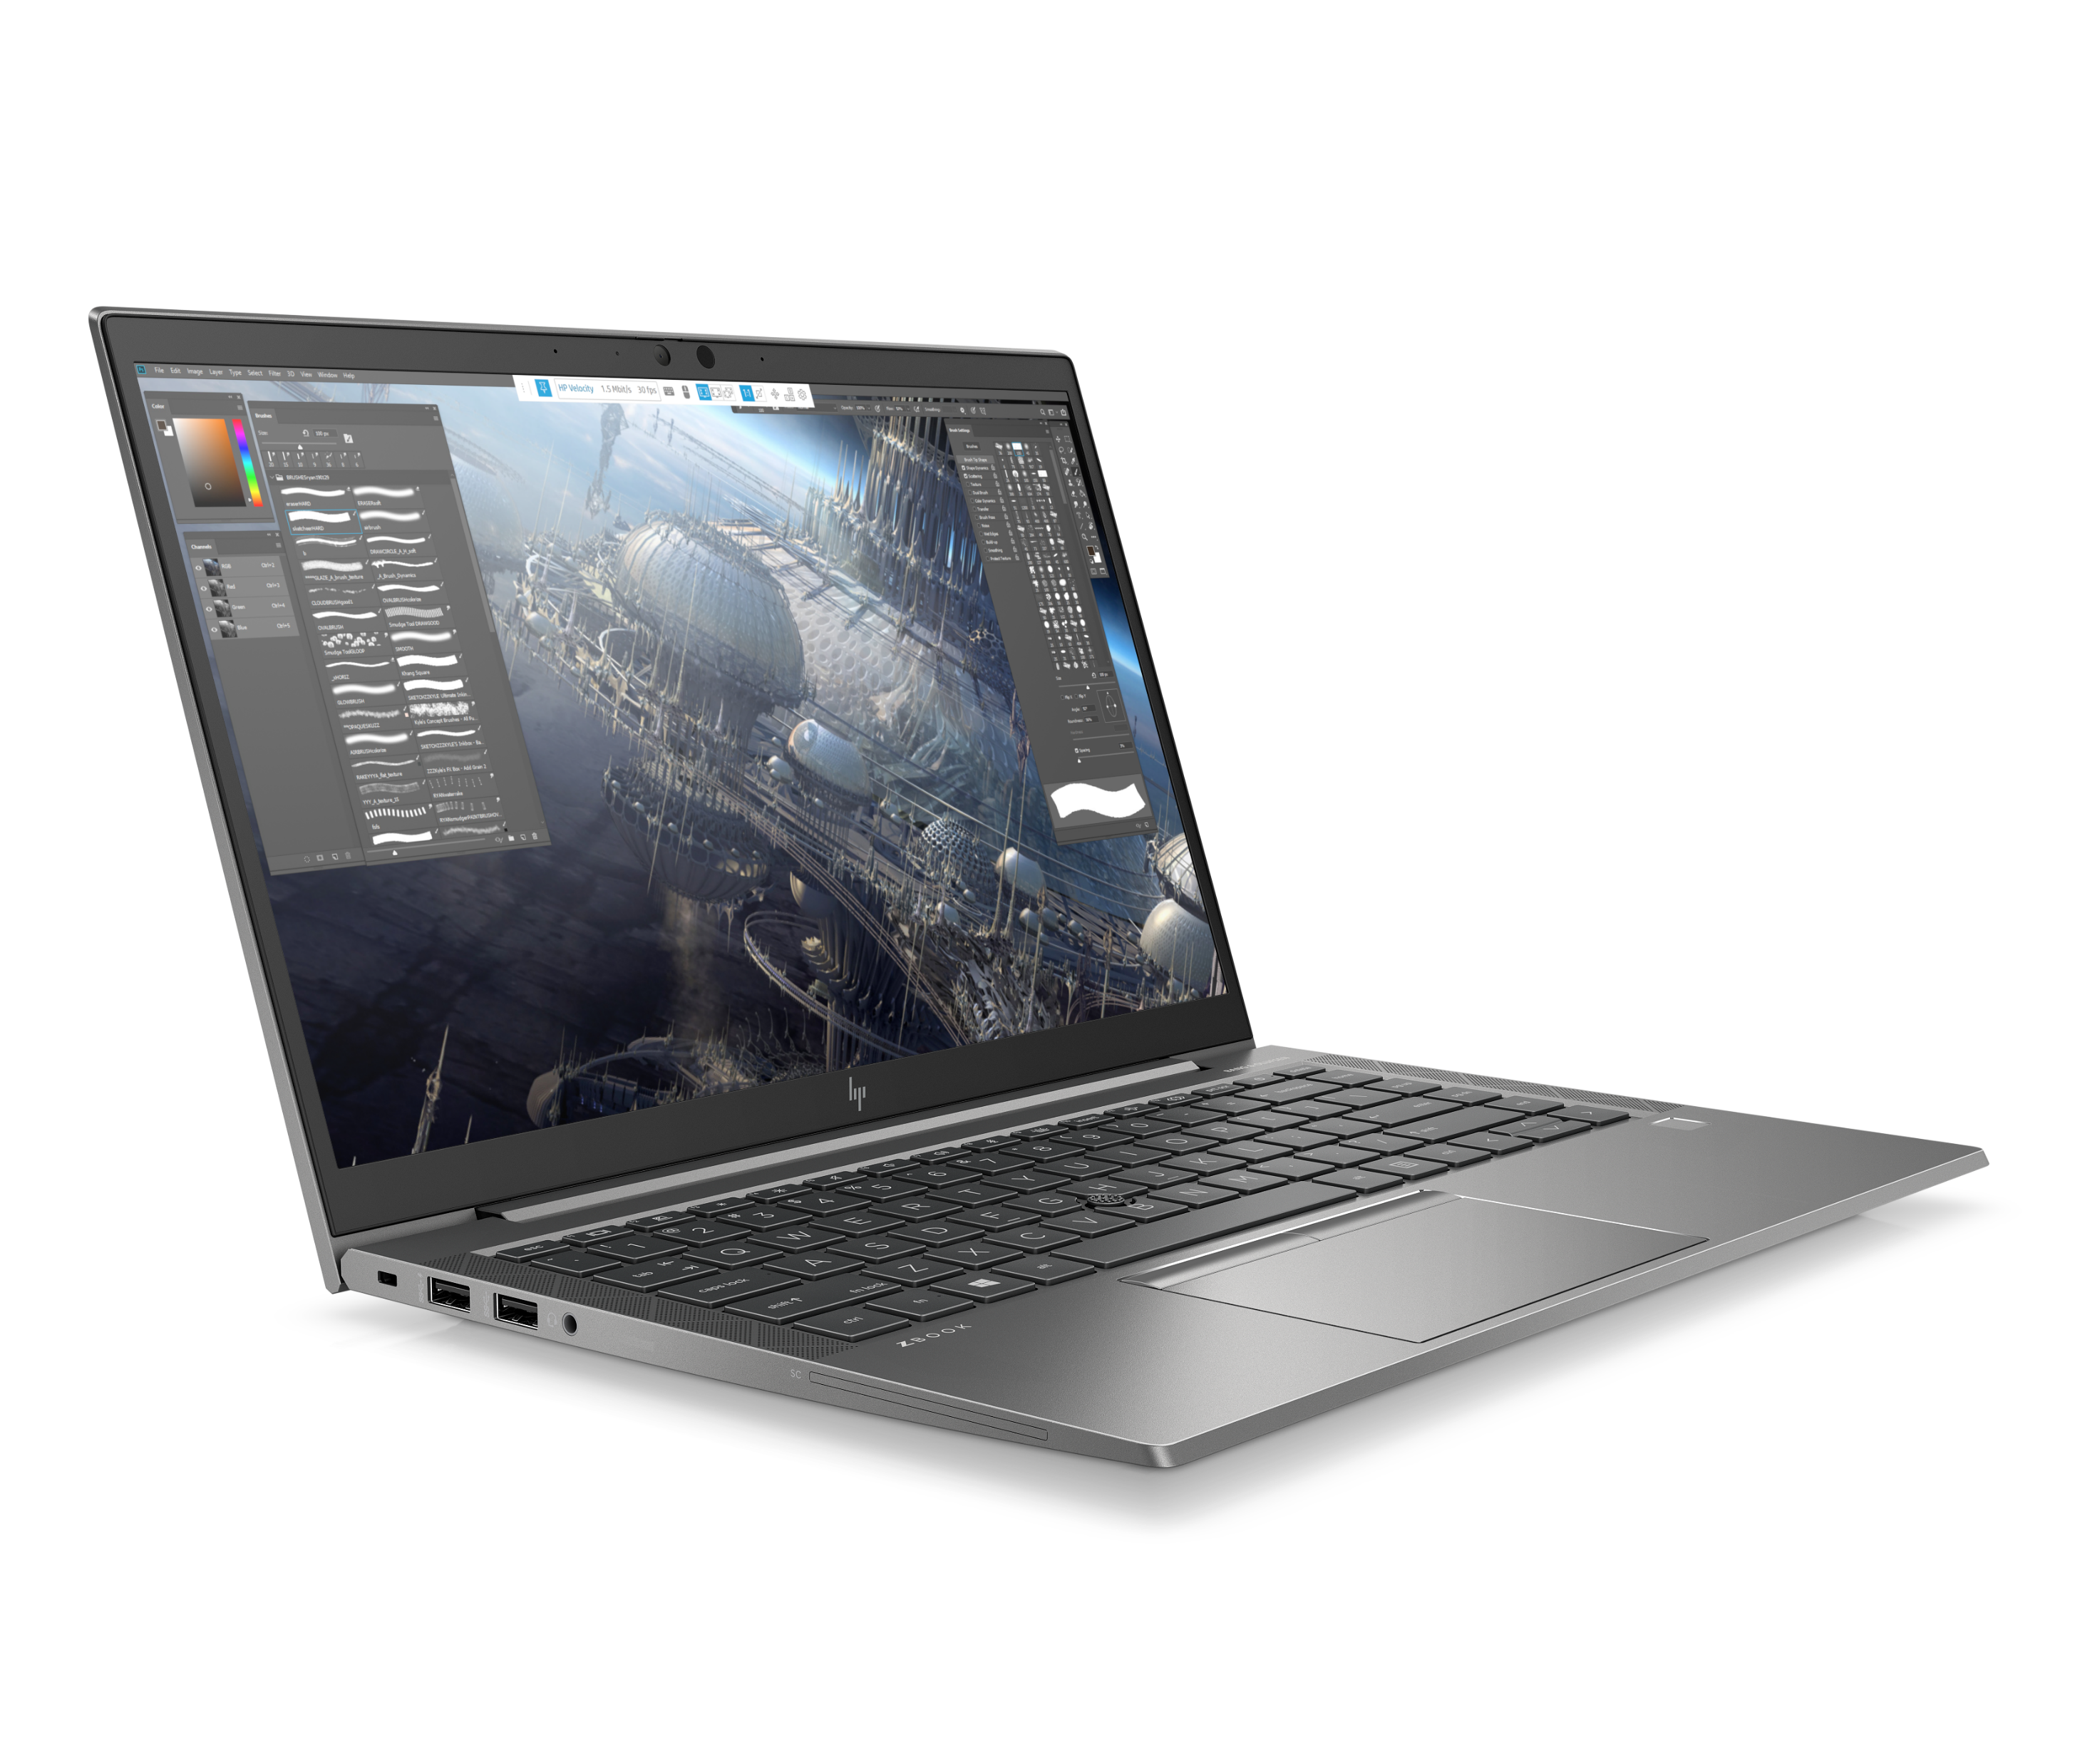
HP Is the First Workstation Manufacturer to use Ocean-Bound Plastics⁶
With continuous improvements year over year
2020
2022 & Beyond
All new launches of Z Desktop and Mobile Workstations* contain:
  Speaker enclosure contain 5% ocean bound plastic
  Axial fans contain 25% ocean bound plastic⁹
  Outer box and fiber cushions are 100% sustainably sourced¹⁰
ZBook Studio G7
ZBook Firefly 14 G7
World’s first mobile workstation with ocean-bound plastics⁷
World's first 14" mobile workstation with ocean-bound plastics⁸
HP Confidential. For use by HP or Partner with Customers under HP CDA only.
Notes:
Z by HP is reducing plastics entering the world’s oceans by using ocean bound plastic in our products. Ocean Bound Plastic is defined as plastic collected for recycling within 50 mi of a coast.
Through HP’s innovation of a new resin, ocean bound plastic will be used in 5% of the speaker enclosure in the HP ZBook Studio and HP ZBook Create. This will have a meaningful impact on not only the amount of plastics bound for the ocean, but also reduces the amount of fresh resin production required to make the product. It also increases employment opportunities for people in Haiti that are gathering and processing the ocean bound plastic.
This new resin type allows us to use even more ocean bound plastic per pound of material in products than we have previously accomplished, which helps reduce the amount of plastic garbage that ends up in the World’s oceans.
All new releases of Z by HP products will contain Ocean Bound Plastics. HP is continually looking for ways to use more Ocean Bound Plastic in new resin formulations.
DISCLAIMERS:
6. Speaker closure contains 5% ocean bound plastics.
7. Based on HP internal analysis of ISV certified mobile workstations as of April 2020. Speaker enclosure component made with 5% ocean bound plastic.
8. Based on HP internal analysis of ISV certified mobile workstations as of May 2020. Speaker enclosure component made with 5% ocean bound plastic.
9. 100% outer box packaging made from sustainably source certified and recycled fibers. Fiber cushions made from 100% recycled wood fiber and organic material. Any plastic cushions are made from >90% recycled plastic.
10. Fans contain up to 25% ocean-bound plastic by weight.
This slide contains a superlative claim/s that cannot be used in all countries:
EMEA Use Restrictions: DO NOT USE the superlative claim in the following countries: Romania, Slovakia, Turkey, UAE, Russia, CIS countries (Armenia, Belarus, Kazakhstan, Kyrgyzstan, Moldova, Russia, Tajikistan, Turkmenistan, Ukraine, and Uzbekistan),
APJ Use Restrictions: China, Vietnam, Indonesia, Malaysia – DO NOT use
LAR Use Restrictions: Brazil, Mexico – Do NOT use

Slide 13




Innovation For A More Sustainable World
Z is innovating with new materials to protect the earth and human health
All Z desktops are tested to ensure the removal of substances of concern
All ZBooks and Z displays have mercury-free LED backlights & arsenic-free display glass
Z selects safer materials based on Green Screen® for safer chemicals methodology
HP Confidential. For use by HP or Partner with Customers under HP CDA only.
Notes:
HP is committed to being a leader in the area of sustainable personal computing because it’s the right thing to do.
A system that is not designed with materials sustainability in mind may have long term negative and environmental health effects. These issues can occur during manufacture, use, and final disposal.
For example in the short term, a system not designed for energy efficiency may drive user power costs up considerably.
Z by HP innovates with new materials to protect the earth and human health by ensuring the removal of materials restricted by entities around the world, required to be eliminated by ecolabels (EPEAT®, TCO, Green Screen®), and are voluntarily restricted by HP. The goal of making systems free of substances of concern benefits every single person on Earth.
All workstation products are low halogen (except for power cables). PVC and BFR free
All Z desktops are tested to ensure the removal of substances of concern
HP Workstations use fewer toxic materials (such as lead, bromine, mercury, cadmium, beryllium, antimony) to reduce the amount of cancer-causing substances when our products are created and disposed of
All ZBooks have mercury free LED backlights & arsenic free display
We design Z by HP workstations for quality and durability, to keep valuable materials in use for a long time.
Z is also selecting safer materials based on Green Screen® methodology for safer chemicals

Slide 14
Disclaimers & sources
Applies to HP PCs, Workstations and Displays manufactured after January 2019. Based on most Gold and Silver EPEAT® registrations by meeting all required criteria and achieving 50-74% of the optional points for EPEAT® Silver and 75-100% of the optional points for EPEAT® Gold according to IEEE 1680.1-2018 EPEAT®. Status varies by country. Visit www.epeat.net for more information.
2. Based on US EPEAT® registration according to IEEE 1680.1-2018 EPEAT®. EPEAT® status varies by country. Visit www.epeat.net for more information
In 2020, all new launches of HP Elite, HP Pro, and Z Workstation desktop and notebook computers will include ocean bound plastic material.Speaker enclosure made with 5% ocean bound plastic.Applies to all products launching after January 1, 2020.Claim can be used with HP or Environmental marketing messaging. Claim can be used with portfolio messaging only when referencing product models launched after January 1, 2020. (No general messaging of HP Elite, HP Pro, and Z Workstation desktop and notebook computers made with ocean bound plastic without referencing a product(s) launched after January 1, 2020).
All HP Workstations are Epeat gold certified except HP ZCentral 4R Workstation
10. Based on US EPEAT® registration for desktop workstations according to IEEE 1680.1-2018 EPEAT® applicable to the HP Z4, Z6, and Z8 G4 as of October 2019.
Based on US EPEAT® registration for desktop workstations as of April 2020. Speaker closure contains 5% ocean bound plastics.
7. Based on HP internal analysis of ISV certified mobile workstations as of April 2020. Speaker enclosure component made with 5% ocean bound plastic.
8. Based on HP internal analysis of ISV certified mobile workstations as of May 2020. Speaker enclosure component made with 5% ocean bound plastic.
9. 100% outer box packaging made from sustainably source certified and recycled fibers. Fiber cushions made from 100% recycled wood fiber and organic material. Any plastic cushions are made from >90% recycled plastic.
10. Fans contain up to 25% ocean-bound plastic by weight.
HP Confidential. For use by HP or Partner with Customers under HP CDA only.

Slide 15

Keep reinventing
www.HP.com/sustainability
© Copyright 2020 HP Development Company, L.P. The information contained herein is subject to change without notice.

